Slide 1
Introduction to openIMIS a self-paced e-learning course
Notes:
Welcome to this self-pased e-learning course on openIMIS.

Slide 2
Overview
Module 1: The basics
Module 2: openIMIS and national eHealth structure
Module 3: openIMIS use cases
Module 4: Sustainability & the role of the openIMIS Community
Duration: overall approx. 2 hours 30min
Notes:
The course is based on a modular structure with 4 modules.
Module 1 will cover the basics, so an introduction to key health systems and health financing terms, to set the scene and then an introduction to openIMIS.
Then in module 2, we will talk about national eHealth structures and how openIMIS fits in thin them.
Then a series of used cases will be presented.
And finally we will talk about the openIMIS community and the sustainable approach of openIMIS as a global good.

Slide 3
Learning Objectives Module 1 and 2
Module 1: The basics
Understand key health systems and financing terms
Explain the functionalities of openIMIS, including the enrollment and claims processes
Outline the boundaries of openIMIS (what it can and cannot do)
Module 2: openIMIS and national eHealth structure
Relate the position of openIMIS within a national eHealth landscape
Summarize the interoperability of openIMIS with other systems
Compare with other software such as DHIS2 & OpenMRS
Notes:
Here we see a little more in detail the learning objectives of each module.
List all LO

Slide 4
Learning Objectives Module 3 and 4
Module 3: openIMIS use cases
Explain the achievements of openIMIS in selected countries/regions
Show diverse use cases (implementation scenarios) that openIMIS can serve: health insurance, employment injury insurance, cash transfer, in-kind transfer etc.
Compare the processes of implementation in the shown cases
Module 4: Sustainability & the role of the openIMIS Community
Discover how the openIMIS Community can support new implementation teams and how learning from local implementations benefit the global product and community
Appraise the value of being par of the openIMIS community
Notes:
Here we see a little more in detail the learning objectives of each module.
List all LO

Slide 5






Credits
The development of this e-learning course was supported by:

Slide 6
Introduction to openIMIS Module 1: The basics
Presented by
openIMIS Initiative
Inputs by
Daniella Majakari (Swiss TPH), Konstanze Lang (GIZ), Rodrigo Assumpcao (ILO)
Notes:
Let’s get started with the basics.

Slide 7
Overview
Learning objectives:
Understand key terms of health systems and health financing
Explain the functionalities of openIMIS, including the enrollment and claims processes
Outline the boundaries of openIMIS (what it can and cannot do)
Duration: approx. 40-50 min
Module 1

Slide 8
Agenda Part 1
Introduction to key Health Systems & Health Financing concepts:
Health Systems Building Blocks
Universal Health Coverage
Health Financing & its mechanisms
Health Insurance Systems & their role in achieving UHC
Health Information Systems
Module 1
Notes:
This is the detailed agenda for this module with two distinct blocks as mentioned before: first an introduction to key health systems and health financing concepts and then we will get into openIMIS and what it does.

Slide 9
Agenda Part 2
Introduction to openIMIS:
Introduction to openIMIS
Rationale of openIMIS
openIMIS developments
Communication within openIMIS
openIMIS functionalities
Summary of openIMIS
Outlook on the next module
Module 1
Notes:
This is the detailed agenda for this module with two distinct blocks as mentioned before: first an introduction to key health systems and health financing concepts and then we will get into openIMIS and what it does.

Slide 10
Introduction to Health Systems & Health Financing

Slide 11
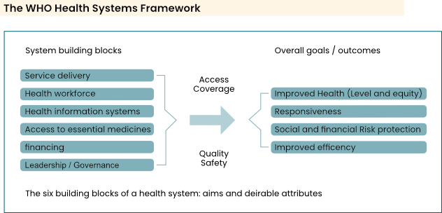
Health System Building Blocks

Slide 12
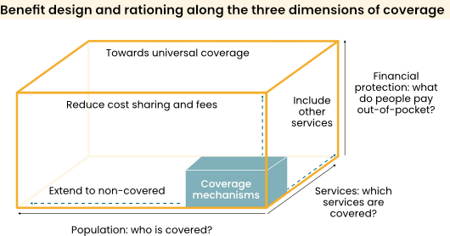
Universal Health Coverage – UHC Cube
Notes:
So, now, what is universal health coverage?
Universal Health Coverage means that all people have access to required health services, when and where they need them, without financial hardship.
This can be seen in this figure: the UHC cube, which is often used in health financing strategies.
It contains three main dimensions: the covered population at the bottom, the covered services to the right (not only quantity but quality) and the financial protection to the top (trying to reduce OOP expenditures). To attain UHC, all three dimensions must be covered.
One can then assess a country’s «status» with this cube: maybe they have a very good health insurance in place so people, which covers people financially but this insurance is not mandatory so the whole population is not covered. Or the other way around, the whole population is covered but the number of services provided is very low and people end up paying for a lot of services with out-of-pocket payments.

Slide 13
Health Information and UHC
A well-functioning health information system is important in achiveing UHC:
The building blocks under the WHO Health Systems Framework rely on timely and reliable information such as:
What is the covered population?
Are people getting the services they require?
How high are OOP expendiures?

Slide 14
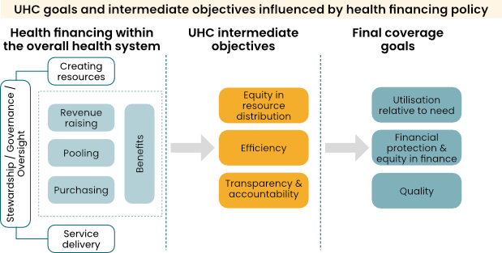
Health Financing

Slide 15
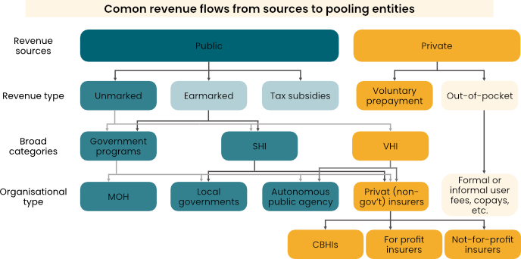
Various Health Financing Mechanisms

Slide 16
Health Insurance & Its Role Towards UHC
Advantages:
Additional funding for health
Better value for money (increasing efficiency/controlling cost)
Improving quality and targeting of healthcare (increased effectiveness)
Challenges:
Scarcity of money (revenue source)
Weak management capacity and infrastructures
Informal sector difficult to capture
Regional disparities
Weak regulation

Slide 17
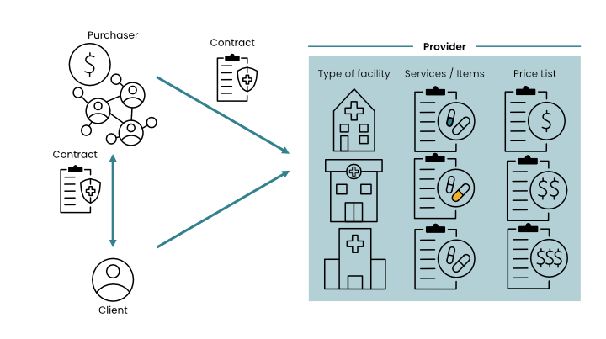
Health Insurance Systems

Slide 18
Health Insurance Processes
Enrolment/Beneficiary Management
Health Service Utilization by insured clients
Claims processing (submission, scrutiny and payment)
Renewals (and/or modification)

Slide 19
Quizz
Universal Health Coverage means that… all people have access to required health services, when and where they need them, without financial hardship. Wrong answer: … vulnerable people have access to primary health care services, … all out-of-pocket expenses are eradicated.
Which are the three key actors in a health system? (purchaser, client, provider) wrong answer: Ministry of Health, Pharmaceutical Companies, Telecommunications companies, hospitals
What are common challenges with health insurance schemes, especially in low- and middle-income settings? Wrong answers: Scarcity of health practitioners, Not enough patients, too many patients, data privacy
Module 1

Slide 20
Introduction to openIMIS

Slide 21
Background
The success of health financing/social protection schemes depend on highly efficient implementation of multiple, complex business processes.
Scheme operators in low- and middle-income countries struggle to achieve efficiencies in these schemes when they lack access to appropriate digital technologies.
Build own IT system
Buy commercial
Use opensource ?

Slide 22
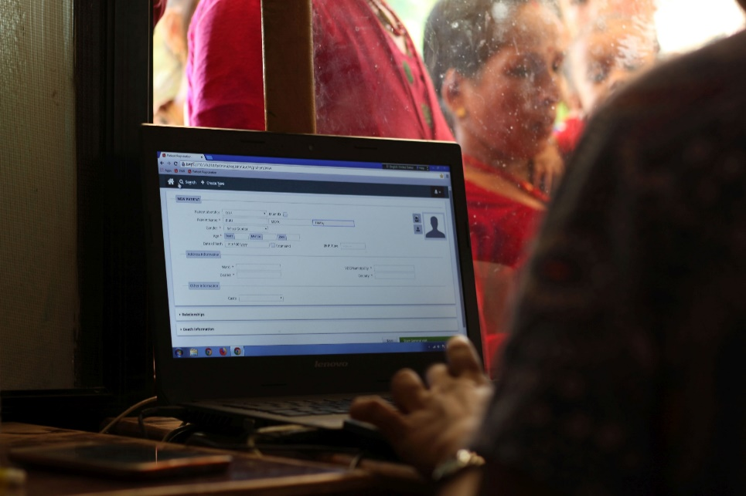
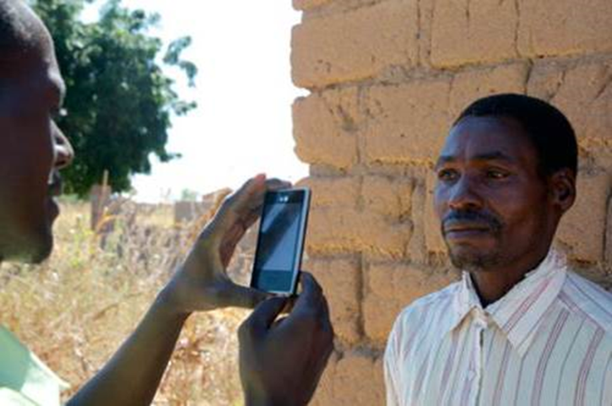
What is openIMIS?
openIMIS is an
open source software for manging social protection processes. It helps digitzing the link between beneficiaries, providers and payers for social protection.
It is supported by a
community of developers, users and implementers
With the joint mission to
Increase and improve access to universal health coverage (UHC) and universal social protection (USP)

Slide 23
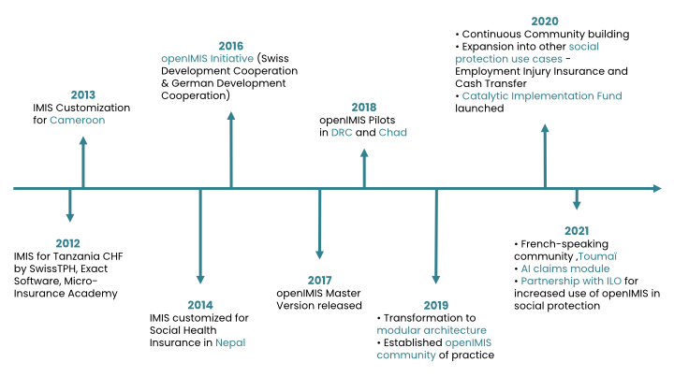
The History

Slide 24
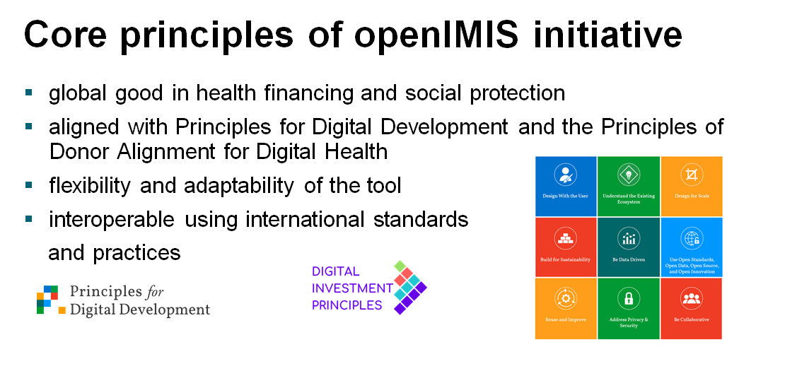
Notes:
-

Slide 25
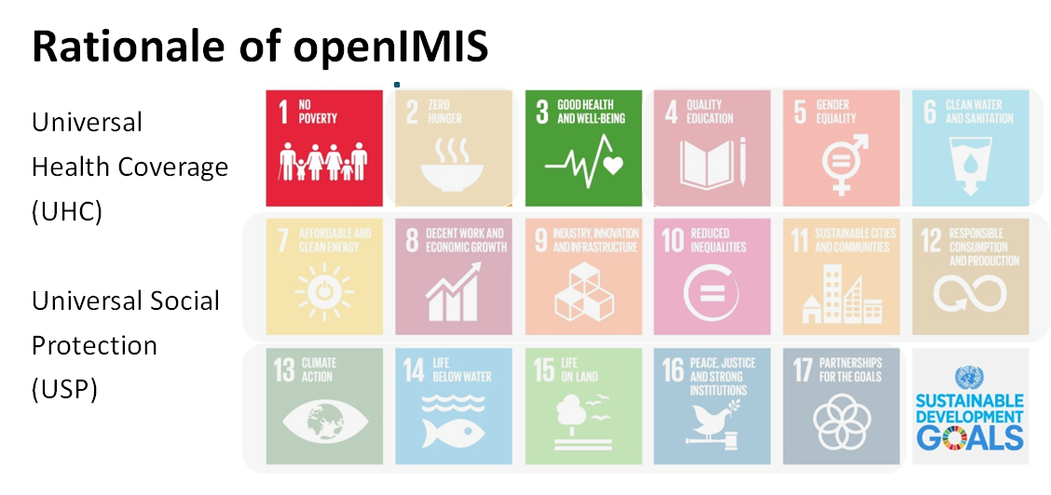
Notes:
-

Slide 26
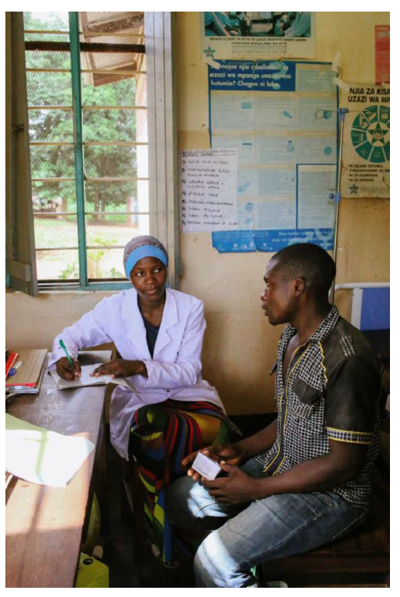
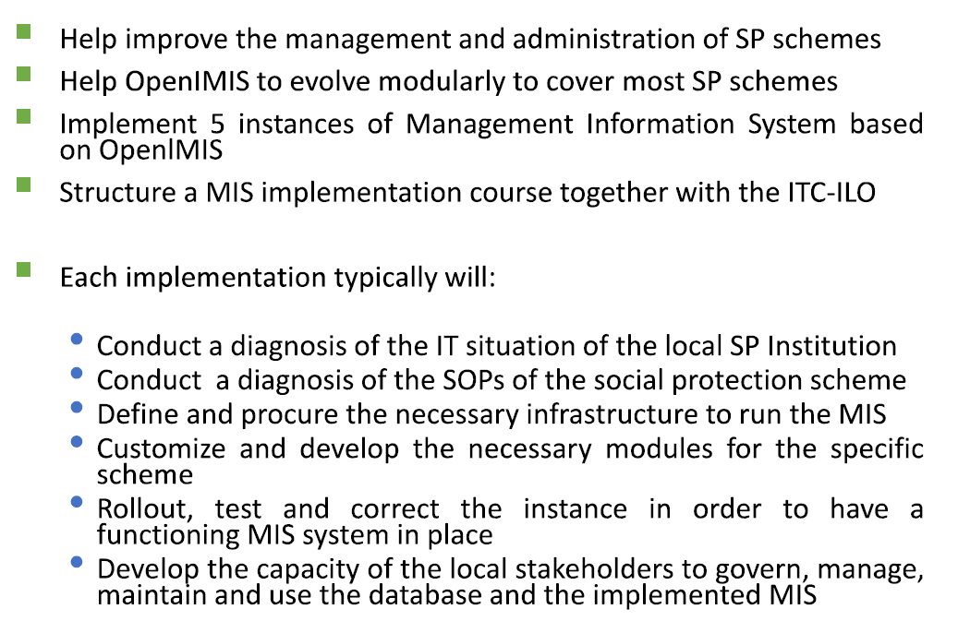
ILO Collaboration: Implementation in SP

Slide 27
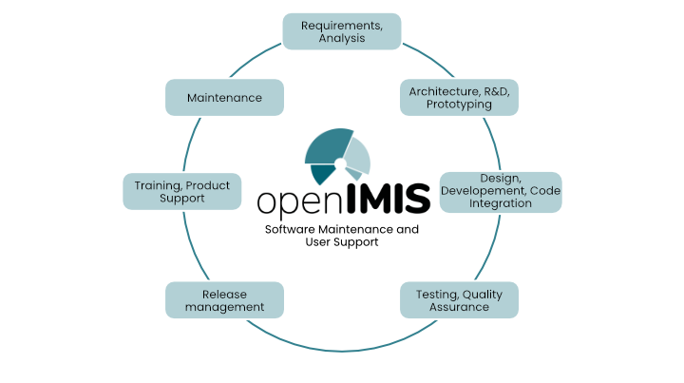
openIMIS Developments
The openIMIS product is constantly being developed and improved.
It is released on a bi-annual rhythm (April and October).
re-architecture from legacy (based on Microsoft and Adroid Technoligies) to modular version (based on Python/Django and Javascript/React)
Context specific customizations

Slide 28
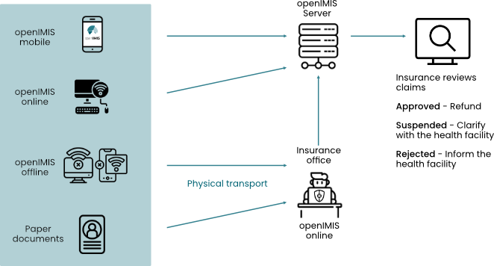
Information Flows within openIMIS

Slide 29
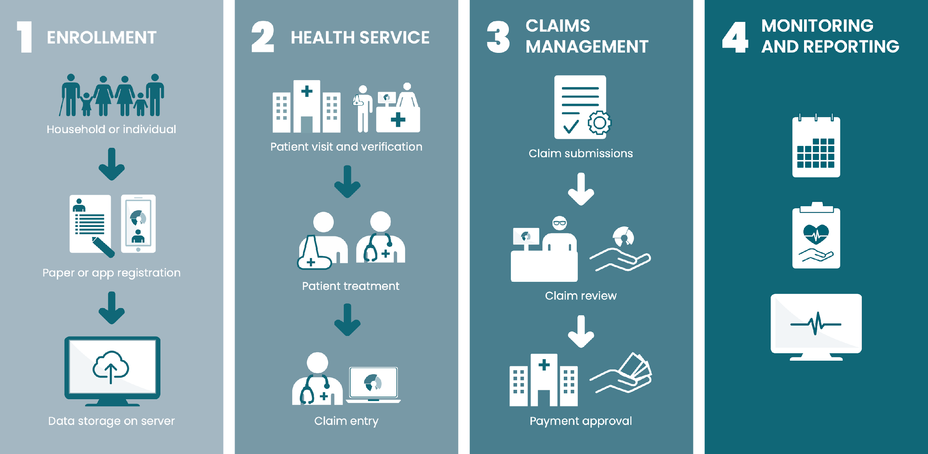
openIMIS Workflows for Health Financing
SERVICE UTILIZATION

Slide 30
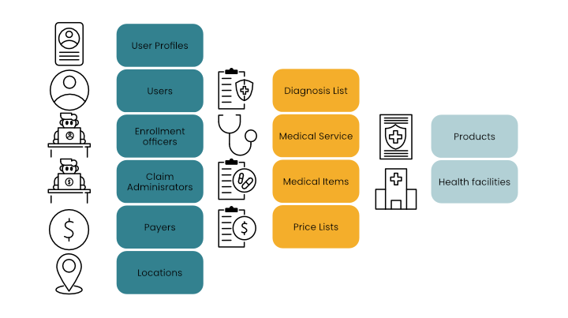
Definition of Registers

Slide 31
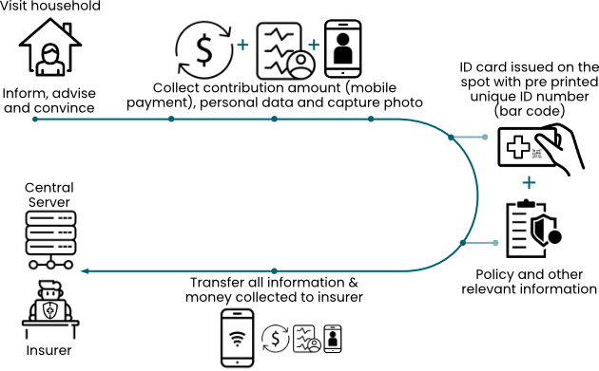
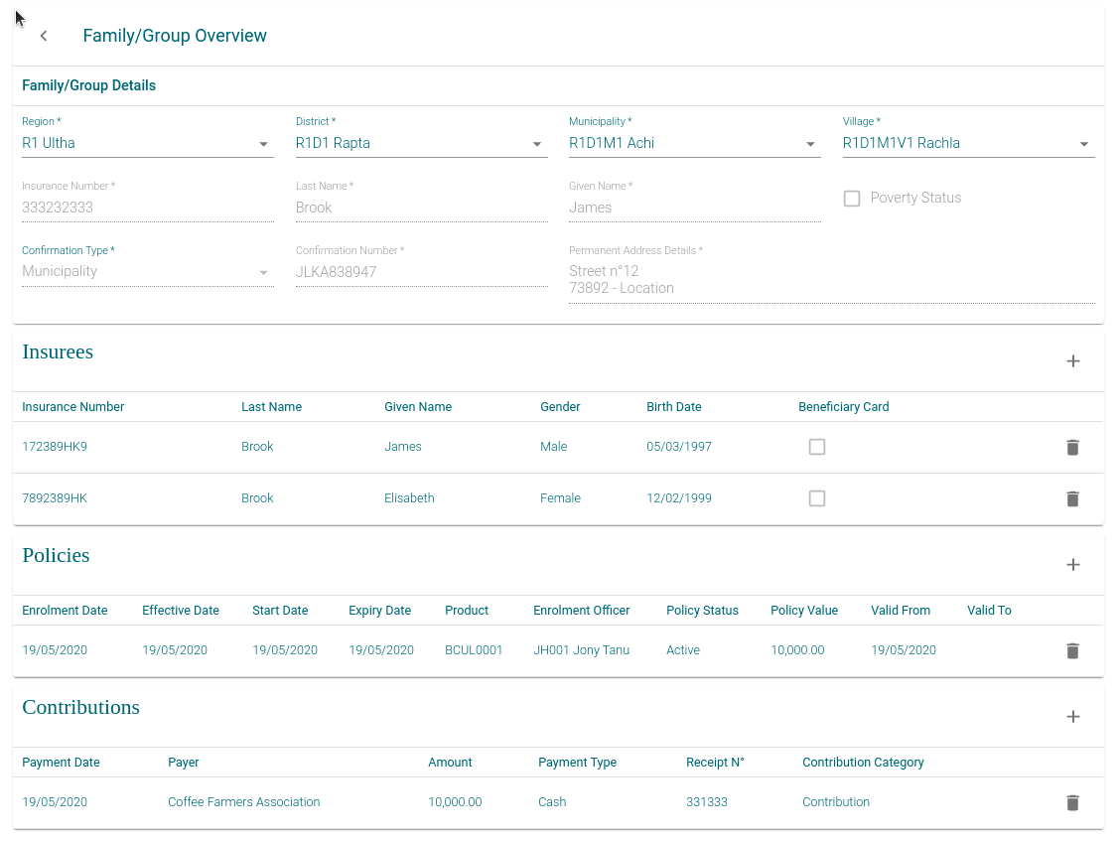
Enrollment

Slide 32
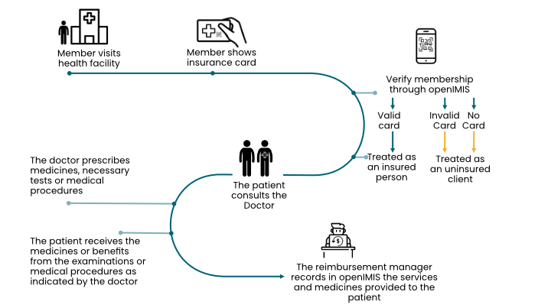
Service Utilization & Claims Management

Slide 33
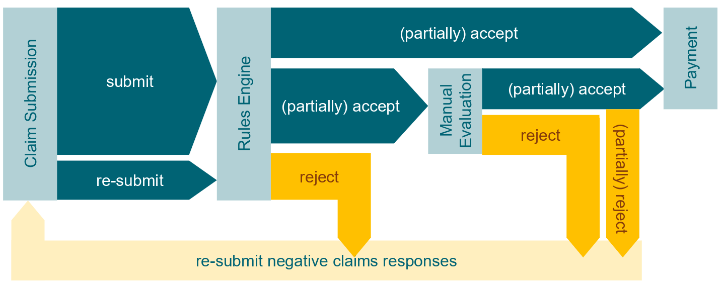
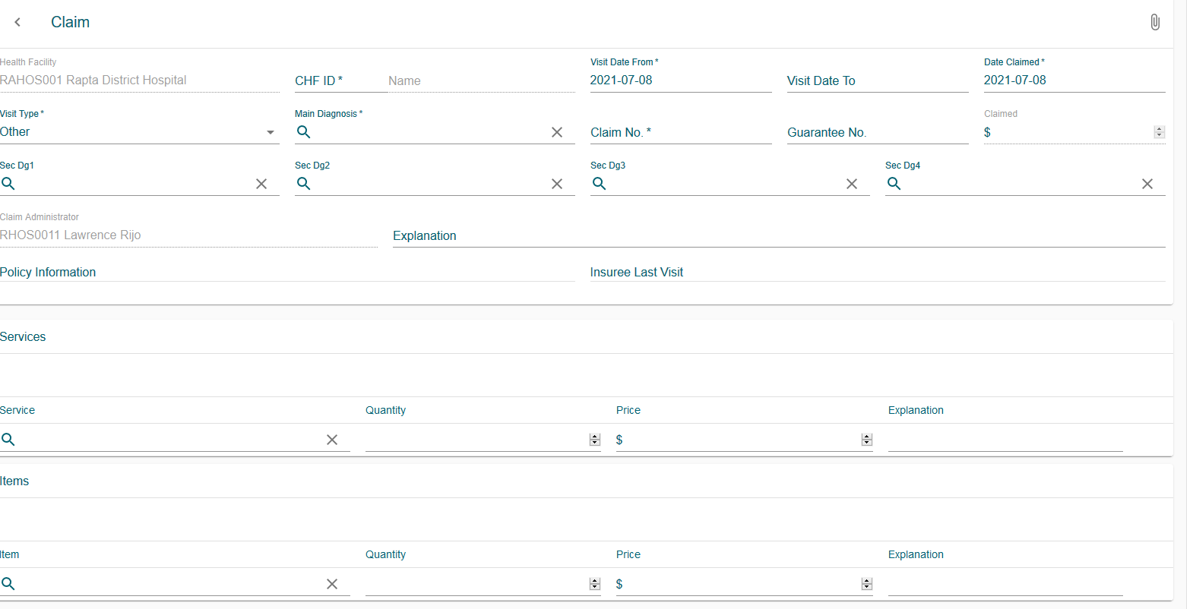
Claims Management

Slide 34
Monitoring & Reporting
Standard operational reports:
Primary operational indicators-policies & claims
Derived operational indicators
Contribution collection
Product sales
Contribution distribution
User activity report
Enrolment performance indicators
Status of registers
Insurees without photos
Matching funds
Claim overview
Percentage of referrals
Families and insures overview
Pending insures
Renewals
Capitation payment
Rejected photos

Slide 35
Quizz
What link does openIMIS help digitize? (link between beneficiaires, payers and providers for social protection) wrong answer: link between hospitals and patients, link between healt insurance, clients and hospitals
How many modes are available for openIMIS (3, online, offline and mobile) Wrong asnwer: 1 (online), 2 (online, mobile)
What are the 4 openIMIS workflows (enrollment, service utilization, claims management, reporting and monitoring) wrong answers: electronic health records, contribution payment, accounting
Under which module does one configure the registers in openIMIS? (administration) Wrong answers: insurees & policies, claims, tools
Module 1

Slide 36
Outlook on Module 2
eHealth Architecture and where openIMIS fits in
Explanation of how openIMIS can be integrated with other systems and used for different types of schemes
ICT governance basics

Slide 37
Further Learning Resources
WHO e-Learning Course on Health Financing Policy for UHC: https://www.who.int/news-room/events/detail/2019/01/29/default-calendar/e-learning-course-on-health-financing-policy-for-universal-health-coverage-(uhc)
openIMIS Demo Server: https://demo.openimis.org/
openIMIS wiki page: Further learning resources - openIMIS - Confluence (atlassian.net)
Module 1

Slide 38
References
WHO (2010) Monitoring the Building Blocks of Health Systems: A Handbook of Indicators and Their Measurement strategies. Available from: https://www.who.int/workforcealliance/knowledge/toolkit/26.pdf?ua=1
WHO (2017) Developing a National Health Financing Strategy: A Reference Guide. Available from: http://apps.who.int/iris/bitstream/handle/10665/254757/9789241512107-eng.pdf;jsessionid=9C7AB97C16203D40718AFED7FD4EC9B8?sequence=1
DFID Health Systems Resource Centre (1998) An Introduction to Health Insurance for Low Income Countries. Available from: https://assets.publishing.service.gov.uk/media/57a08da5e5274a31e0001994/An-introduction-to-Health-Insurance.pdf
openIMIS website: http://openimis.org/
Module 1

